Slide 1

NATURAL LANGUAGE PROCESSING

Slide 2


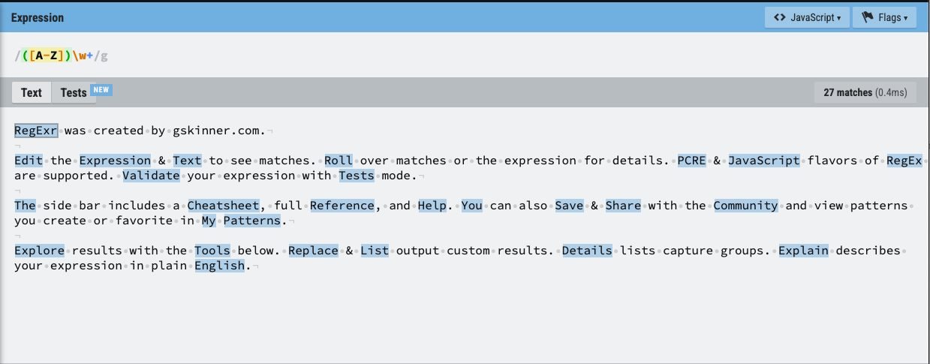
HANDLING TEXT IN ML
NOTE ON REGEX

Slide 3
HANDLING TEXT IN ML
So far, all algorithms that we have seen take as input tabular information with numeric or categorical data (and a brief stint with datetime data when we looked at time series)
There are several areas of application where our data is not natively structured in this way: sound, image and text come to mind
In these situations we often reduce the problem to turning the native data format into a suitable set of features, followed by applying the typical ML algorithms.
In other words: how do we turn text into a suitable set of numbers?

Slide 4
HANDLING TEXT IN ML
Some of this feature generation can and should come from metadata:
•source of text
date of production
author
number / type of interactions
But ultimately it is clear that most of the information must come from the body of the text.
We have seen the bag-of-words model before, but that approach had some shortcomings that we will try to address in this class.

Slide 5
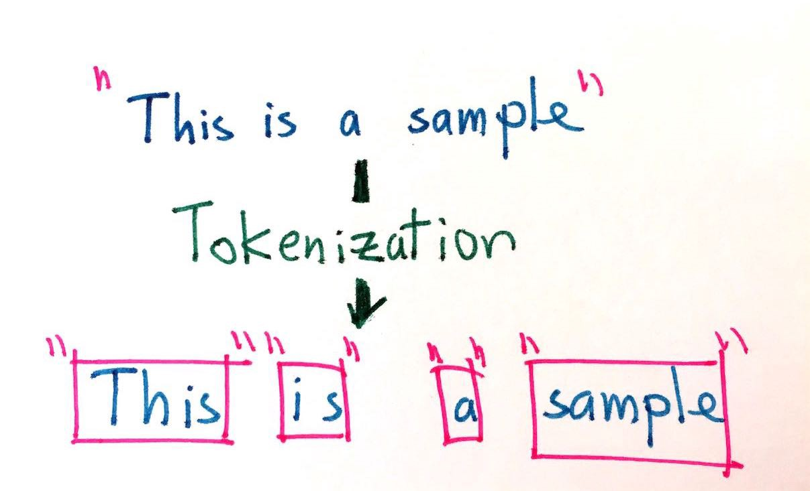

TEXT DATA CLEANING TECHNIQUES
Tokenization
The process involves taking any text and splitting it into "tokens"
Usually the tokens chosen are individual words but can be sentences as well.
PROBLEMS: YOU CAN LOSE IMPORTANT MEANING LIKE "NEW YORK" GETS SPLIT INTO "NEW" AND "YORK" THUS LOSING THE GEOGRAPHICAL MEANING. A GOOD MACHINE LEARNING APPLICATION WOULD TAKE THIS INTO CONSIDERATION BY CONSIDERING THE RELATIVE FREQUENCYOF PAIRS OF WORDS AND PERHAPS KEEP THOSE PAIRS AS A SINGLE WORD

Slide 6
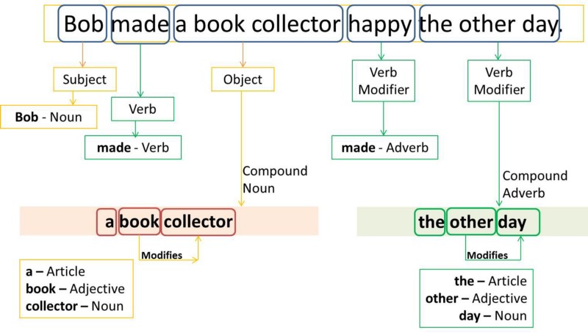
TEXT DATA CLEANING TECHNIQUES
Part-of-Speech tagging (POS)
Can be a very valuable feature
Used heavily in Natural Language Generation (NLG)
In that usecase the "next word" is heavily dependent on the previous

Slide 7
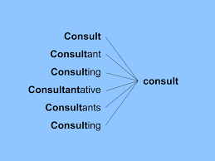
TEXT DATA CLEANING TECHNIQUES
Stemming
Removing prefixes and suffixes in order to reduce synonym words into their common form
This can lead to some problems of creating spurious relations
Stripes -> Strip
Strip -> Strip

Slide 8
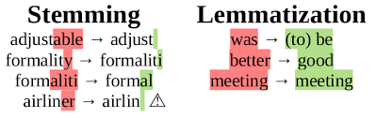
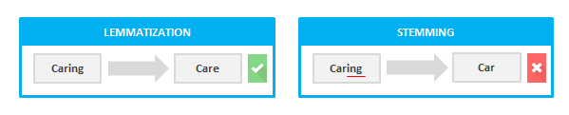
TEXT DATA CLEANING TECHNIQUES
lemmatization looks beyond word reduction and considers a language’s full vocabulary to apply a morphological analysis to words. The lemma of ‘was’ is ‘be’ and the lemma of ‘mice’ is ‘mouse’.

Slide 9
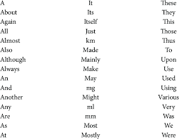
TEXT DATA CLEANING TECHNIQUES
Removal of stop words
Stop words are common words which are usually removed to not be interpreted as noise

Slide 10
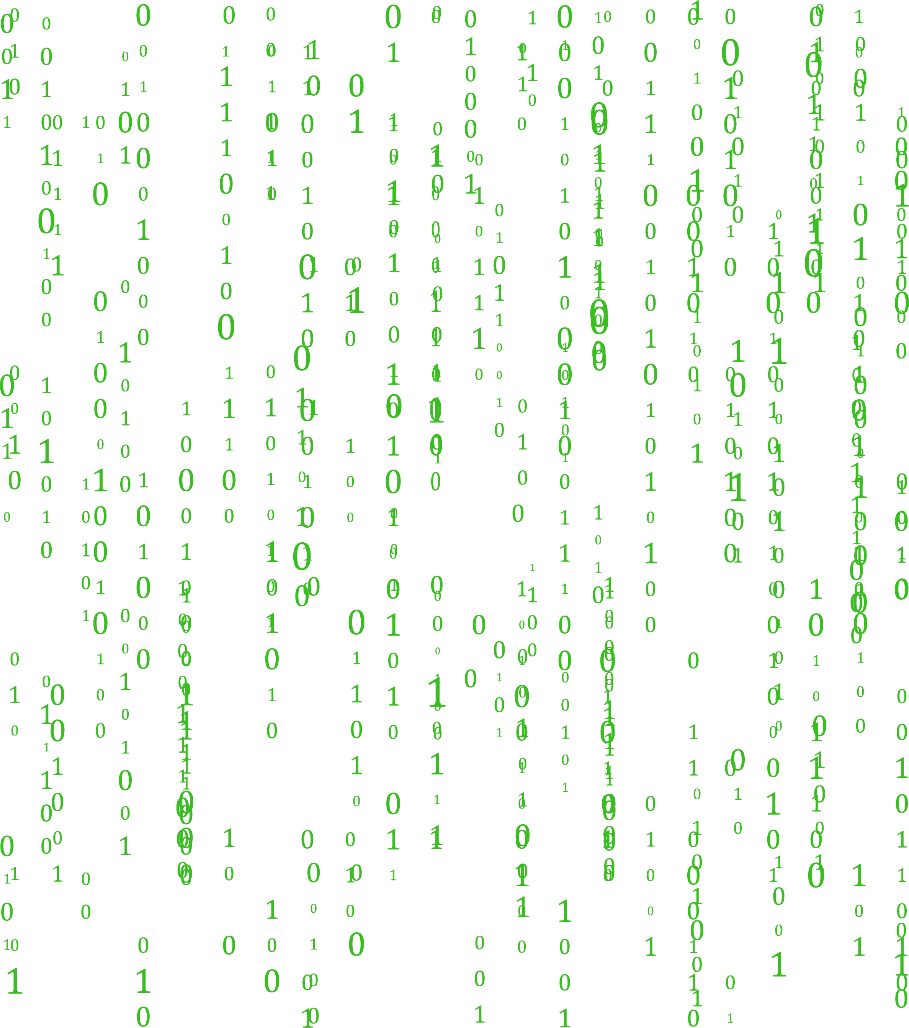
BAG OF WORDS
Bag of Words model is a standard way to decompose any text into several features that can then be used to train a classifier.
The method consists of taking all the words from all the corpuses/documents/rows and performing one-hot encoding. However, the final value is a frequency of the word rather than a binary variable
In essence, each distinct word becomes a feature

Slide 11
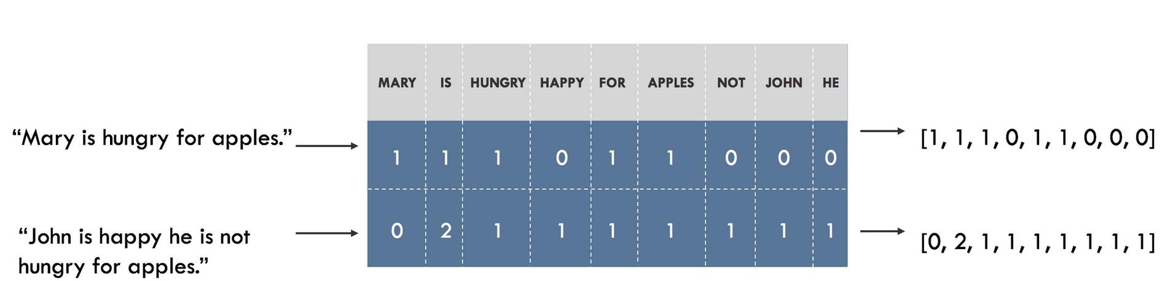

BAG OF WORDS

Slide 12
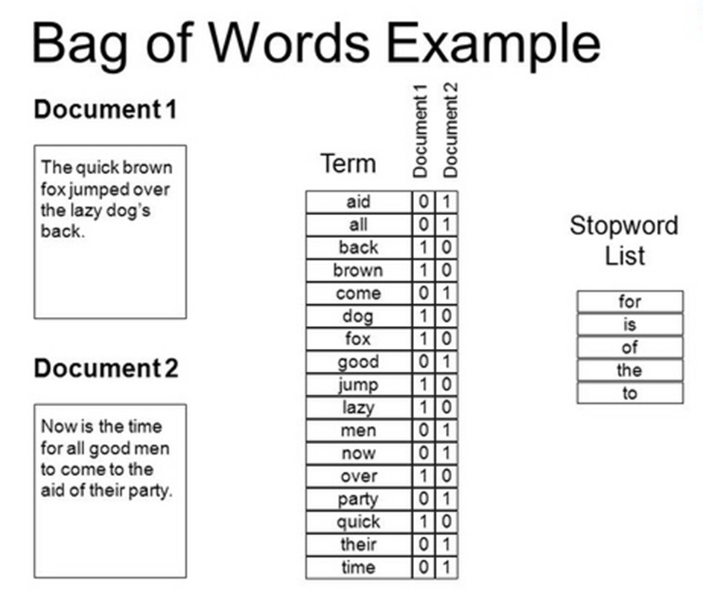
BAG OF WORDS
Problems of bag of words:
- you lose the context of the words within the sentence
- assumes all words are independent
"this is not bad" -> "bad"
solution: N-Grams performing bag of words but with pairs of sequential words for example:
"this is" ; "is not" ; "not bad" would be your features

Slide 13
TF-IDF
Term Frequency Inverse Document Frequency (TF-IDF) is one of the most important feature engineering techniques in natural language processing
Weighs how important a word is in a specific document and how rare it is in all the collections of documents
High TF-IDF score -> word appears many times in a document but is rare in collection of documents -> ”Capitol", "Trump"
Low TF-IDF score -> word that appears moderately in a document but is extremely common in collection of documents -> "Today", "Furthermore"

Slide 14
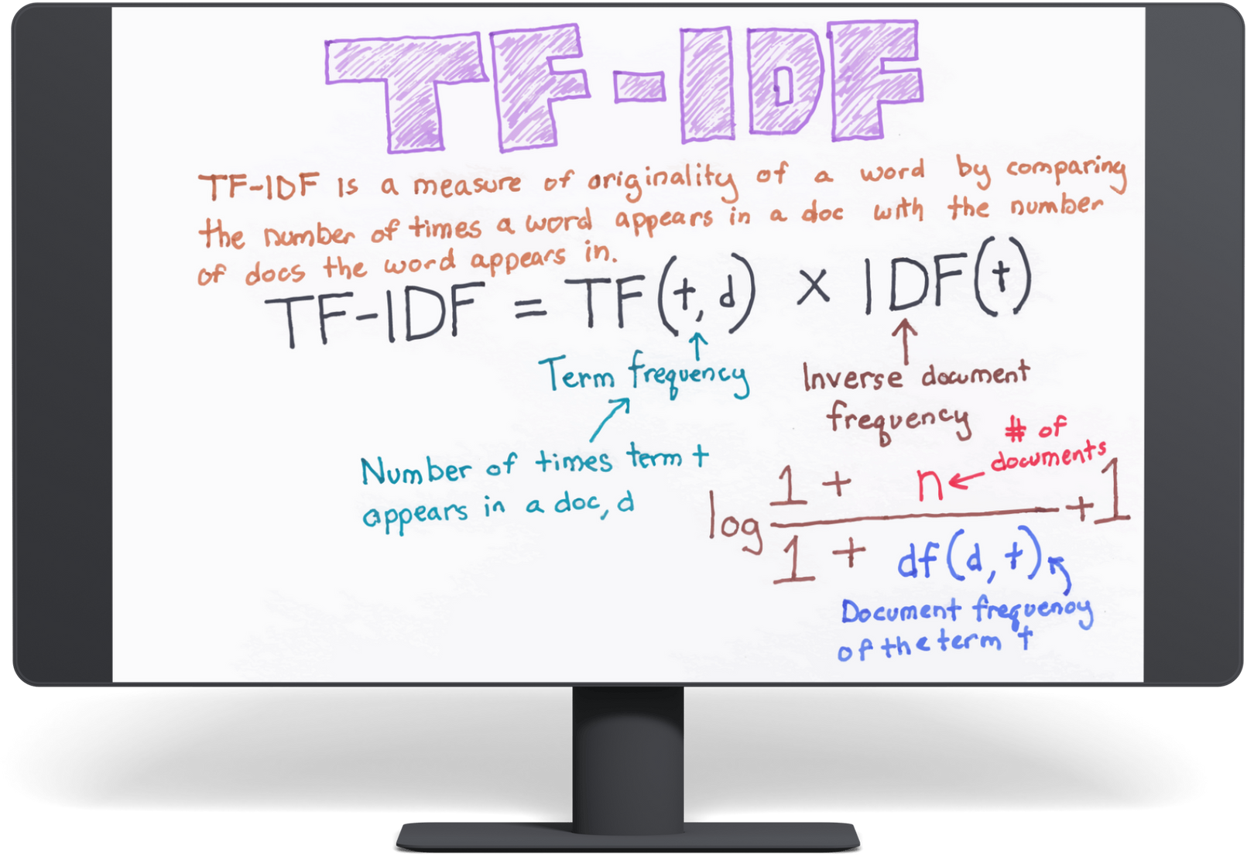
TF-IDF

Slide 15

ANY QUESTIONS ?

